Slide 1

SB FOODS – Online Food Ordering Platform
An Innovative Solution for Seamless Food Delivery

Slide 2
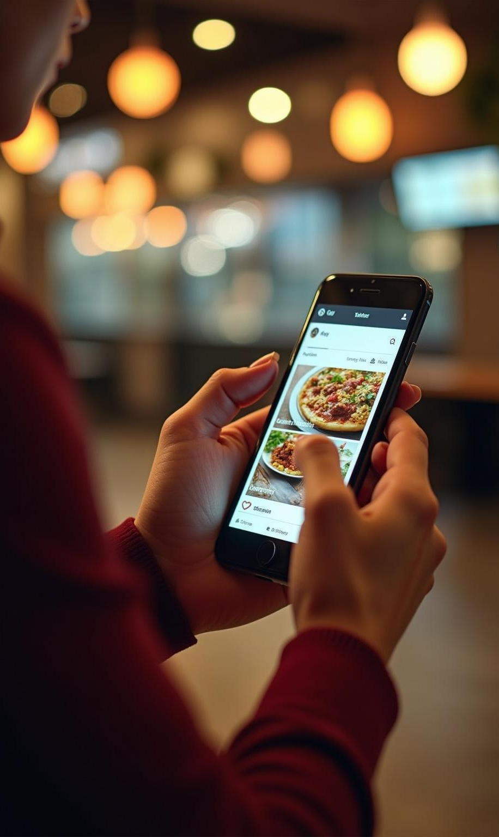
Introduction
SB FOODS is an advanced online food ordering platform designed to enhance the user experience in food delivery. This project addresses common challenges faced by users and aims to provide a seamless, efficient, and enjoyable ordering process. The platform contributes to a more efficient food delivery ecosystem, catering to diverse customer needs and preferences.

Slide 3
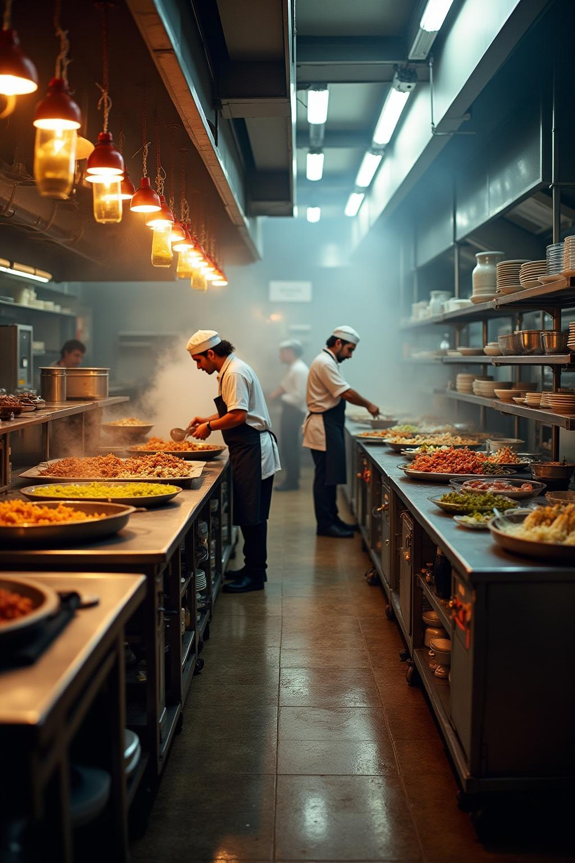
01
Project Overview

Slide 4

Purpose of Development
The primary goal of developing SB FOODS was to solve significant UX challenges in food delivery applications. By focusing on user-centric design and implementing features that enhance interaction, this platform aims to streamline the ordering process, increase customer satisfaction, and ultimately improve food delivery experiences for everyone involved.

Slide 5
Target Audience
The target audience for SB FOODS includes tech-savvy individuals, busy professionals, and food enthusiasts seeking a convenient way to order meals online. It also caters to families looking for easy meal solutions and restaurants aiming to expand their customer base through improved digital interaction. By addressing diverse needs, the platform ensures user satisfaction across various demographics.

Slide 6
Introduction to SB FOODS
SB FOODS revolutionizes online food ordering by merging user-friendly design with powerful functionality. Built on a robust tech stack, it ensures quick access to restaurant menus and simplifies the ordering process. The platform allows users to explore various cuisines, making it easier to satisfy their cravings efficiently.

Slide 7
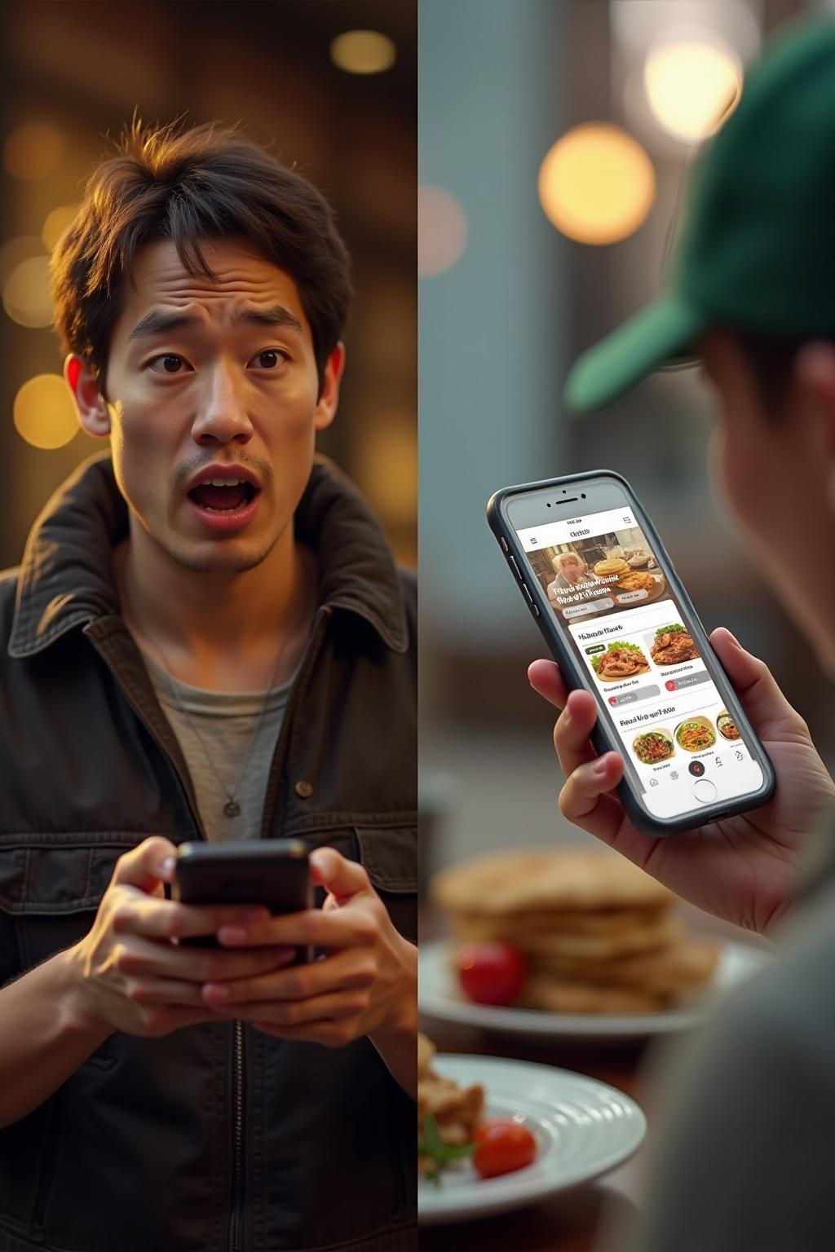
02
Problem Statement

Slide 8
UX Challenges in Food Delivery
Food delivery applications often face significant UX challenges, such as complex navigation, slow loading times, and lack of intuitive design. Users frequently encounter difficulties in finding desired meals or restaurants, which can lead to frustration and ultimately deter usage. The goal of SB FOODS is to mitigate these issues by focusing on a streamlined user experience.

Slide 9

Rationale for App Creation
The development of SB FOODS stems from the need to tackle pervasive UX problems in existing food delivery platforms. By enhancing the user interface and improving functionality, this application aims to provide a solution that fosters user engagement and satisfaction. Understanding pain points enables the creation of a more effective and enjoyable ordering experience.

Slide 10
Expected Impact on Users
SB FOODS strives to transform how users engage with food delivery services. By offering an efficient, intuitive platform, customers can enjoy a seamless ordering process that saves time and enhances their overall satisfaction. The expected impact includes increased loyalty, higher retention rates, and an improved perception of online food ordering as a result of addressing critical user needs.

Slide 11

Conclusions
The introduction of SB FOODS addresses critical UX challenges in the food delivery space, aiming to enhance overall user satisfaction and engagement. By focusing on user-centric design and effective functionality, the platform is poised to make a significant impact on the ordering experience. As a result, it represents a promising advancement in the sector, fostering a more efficient food delivery ecosystem.

Slide 12

Thank You
Team Members:
1.Ch.Mithun(Team Leader)
2.Ch.Jitendra
3.Ch.Mouli

